Slide 1

GATE 6 / BENCHMARK 4 · PRE-CAPSTONE SUBMISSION
READY FOR REVIEW
ShopKart SDET
Automation Framework
Submitted deliverable: framework scaffold, dynamic-XPath locators, disciplined secret-data handling, and the six scenarios automated end to end.
GitHub Repository:
https://github.com/chaithra-03/shopkart-gate6
Project-Team Reference

Slide 2
What's Being Submitted
Evidence for each Gate 6 requirement, in order
01
Tech Stack
02
System Under Test
Toolchain used to build the suite
ShopKart — API, UI, database
03
Framework Structure
04
Locator Strategy
As implemented in the repo
Dynamic XPath, as coded
05
Test Scenarios
06
Data & Secrets
Six scenarios, results included
Builders, isolation, redaction
07
Reporting & Demo
08
Gate Checklist
Allure evidence + recording
Sign-off status
Section Overview

Slide 3







Stack Implemented
The toolchain this submission is built and demoed against
Language / Runtime
BDD / Runner
Java 22 (LTS)
Cucumber 7 · JUnit Platform
API Testing
UI Testing
REST Assured
Selenide — dynamic XPath via $x()
Data / Isolation
Build
Testcontainers 2 · PostgreSQL · Flyway
Gradle (primary) · Maven (variant)
Reporting
Allure — history, categories, executive view
Tech Stack

Slide 4
System Under Test — ShopKart
A minimal e-commerce checkout service: REST API + web UI, backed by PostgreSQL
Web UI
DATA MODEL
http://localhost:8080
Table | Key columns
customers | id · email · password_hash
products | sku · name · price_paise · stock
carts | id · customer_id · status
cart_items | cart_id · sku · qty
orders | id · cart_id · status · total_paise
Rendered pages; dynamic XPath
REST API
http://localhost:8080/api
JSON; Bearer-token auth on cart/order
Database
postgres://localhost:5432/shopkart
Money is stored in paise (integer): ₹499.00 = 49900
Testcontainers gives each class its own
System Under Test

Slide 5
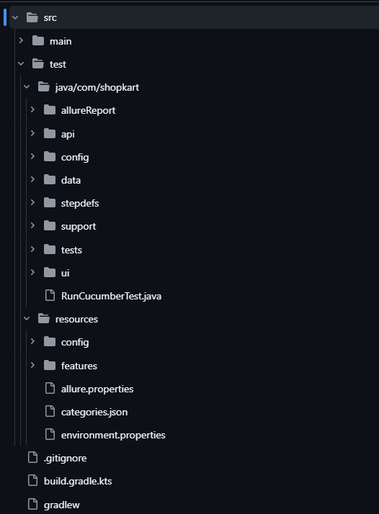

Framework Structure — As Built
Evidence of the required layering — configuration external, locators centralized
Configuration lives outside the code (local / ci)
1
API and UI layers fully separated
2
All dynamic XPath templates in one locator class
3
Data builders sit apart from test logic
4
Step definitions are thin glue — no logic
5
Framework Architecture

Slide 6


Dynamic-XPath Locator Standard
As implemented in Xp.java — relative, attribute/text-anchored, and templated
// ui/locators/Xp.java — all dynamic XPath in one place
public final class Xp {
public static final String PRODUCT =
"//div[contains(@class,'product')]" +
"[.//*[normalize-space()='%s']]";
public static final String ADD_TO_CART =
PRODUCT + "//button[normalize-space()=" +
"'Add to cart']";
public static SelenideElement product(String name) {
return $x(String.format(PRODUCT, name));
}
public static SelenideElement addToCart(String name) {
return $x(String.format(ADD_TO_CART, name));
}
}
Do
Relative paths anchored on stable attributes or visible text
Parameterized templates reused across rows/pages
One locator class, referenced by page objects
Avoid
Absolute XPath from document root
Index-based paths (e.g. tr[3]) that break on reorder
Locators duplicated across page objects
Locator Strategy

Slide 7
Six Scenarios — Results
UI, API, database and a security negative — all automated and passing
# | Feature | Proves | Layers | Priority | Status
1 | Product search | Search returns matching products | UI + API | P1 | ● PASS
2 | Cart totals | Total = Σ(qty × price), in paise | API + DB | P1 | ● PASS
3 | Checkout E2E | Login → search → add → cart → checkout → PLACED | UI → API → DB | P0 | ● PASS
4 | Order access | Owner 200; another customer 403 | API | P0 | ● PASS
5 | Cancel rules | Cancel PLACED → CANCELLED; again → 409 | API | P1 | ● PASS
6 | Out of stock | Add qty > stock → 409 | API | P2 | ● PASS
Full run log and pass evidence are in the Allure report (next section).
Test Scenarios

Slide 8

Test Data & Secret Handling
Implemented as follows — public data seeded and shared, secrets sourced off-repo
Data Strategy
Secret Handling Rules
Seed public reference data with Flyway (V1__schema.sql, V2__seed.sql)
Build per-test data with builders — never shared fixtures
Isolate with Testcontainers — each test class gets its own throwaway Postgres
Keep setup idempotent — re-running from a clean container gives the same result
Never in Git — no secret in a .feature, page object, or committed .properties
Masked everywhere — logs, console, Allure attachments show **** only
Dedicated, rotated test accounts — never a real user's credentials
Feature files stay secret-free — persona named, Secrets.get() resolves at runtime
SKU-CAP has stock 0 — reserved for the out-of-stock negative (Scenario 6)
auth.login("alice@shopkart.test", Secrets.get("alice.password"))
Data & Secret Strategy

Slide 9
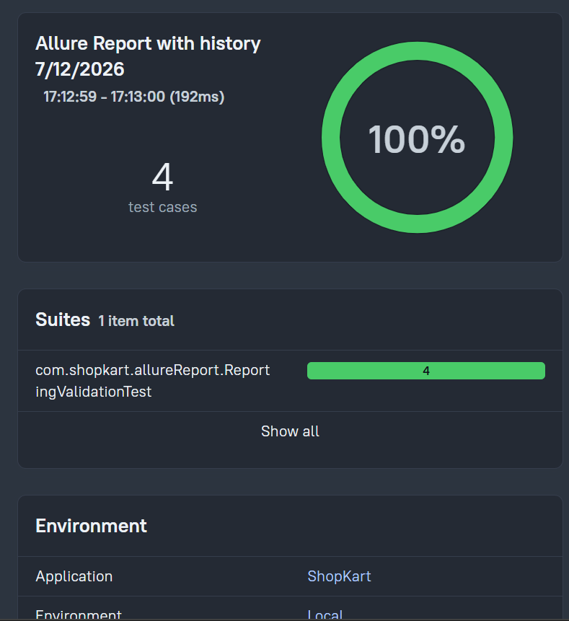
Reporting Evidence & Demo
Allure output from the submitted run, and the recorded walkthrough
Reporting & Demo

Slide 10
Gate Evidence Checklist — Complete
All Gate 6 / Benchmark 4 requirements met by this submission
Green suite run from a cold start (Testcontainers, no local DB)
Data-isolation proof — run twice, identical results, no leftover rows
Framework structure matches spec — Xp locator class, thin steps
Secret handling proof — clean gitleaks scan, Secrets resolver in use
Allure report with history (≥3 runs), categories, no secrets in attachments
Security negative (403) passing
Filled test matrix across all six scenarios
Rehearsed demo, recording verified secret-free
Gate Readiness — Submitted

